Slide 1

Evaluation of Stock Market Trading Algorithms
Carlos Gattorno
George Murnane
William Tate

Slide 2
Our Goal… Create a profitable stock market trading algorithm using one or more deep learning models
Motivation & Summary

Slide 3
Machine learning models we utilized were:
Random Forest
LSTM
Statistical models we explored were:
Exponential Moving Average of Closing Prices
Exponential Moving Average of Daily Return Volatility
Bollinger Band
MODEL(s) SUMMARY

Slide 4
We used Yahoo Finance to get the data for Apple stock from 2016/1/6 to 2021/1/5. Our analysis is daily-based, and all the decisions are made using the closing price on the previous day.
Our analysis started from 50 days after January 6, 2016 and ended on January 5, 2021 (due to using 50-day moving averages).
We used Yahoo Finance and DataReader to obtain and load trading data for Apple stock.
Data cleanup & Exploration

Slide 5
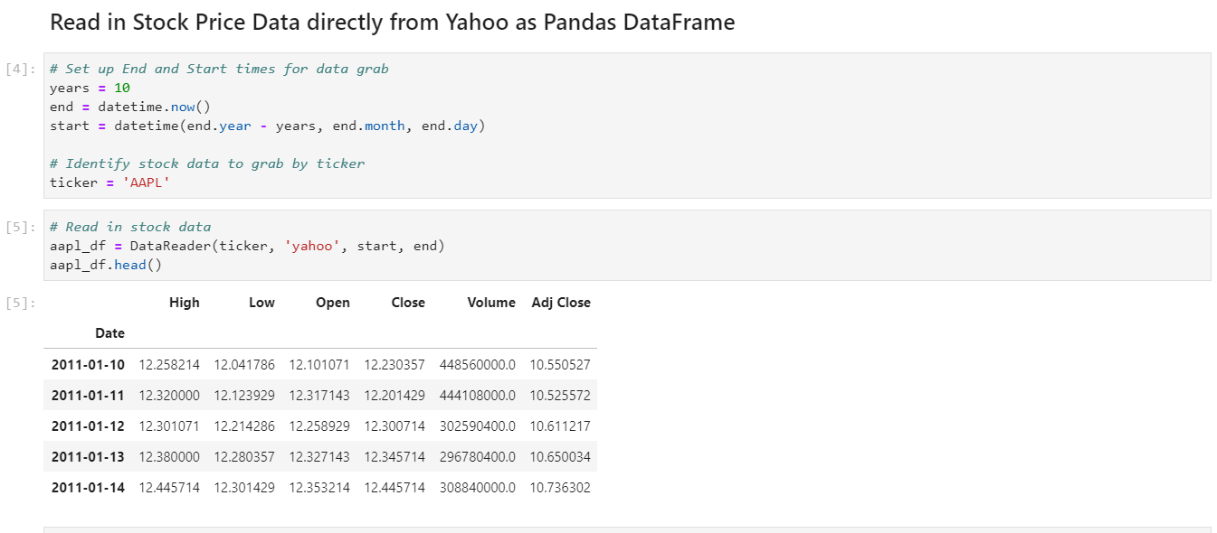
Data cleanup & Exploration (Random Forest)

Slide 6
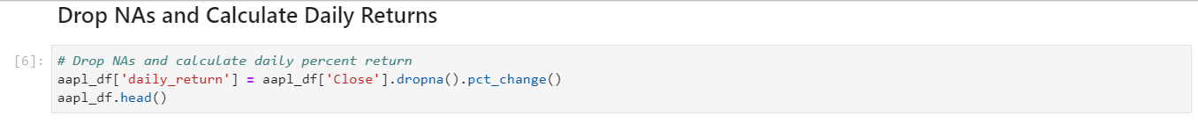
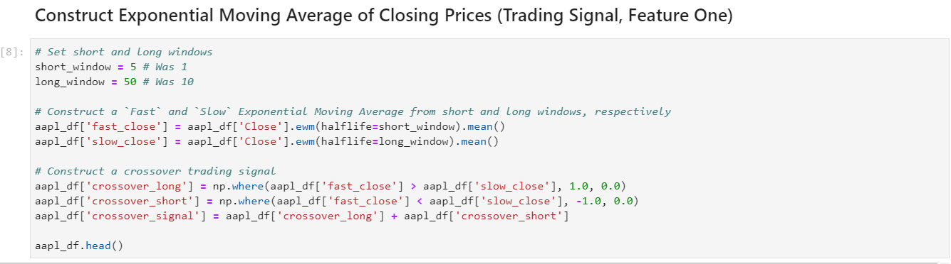
Data cleanup & Exploration (Random Forest)

Slide 7
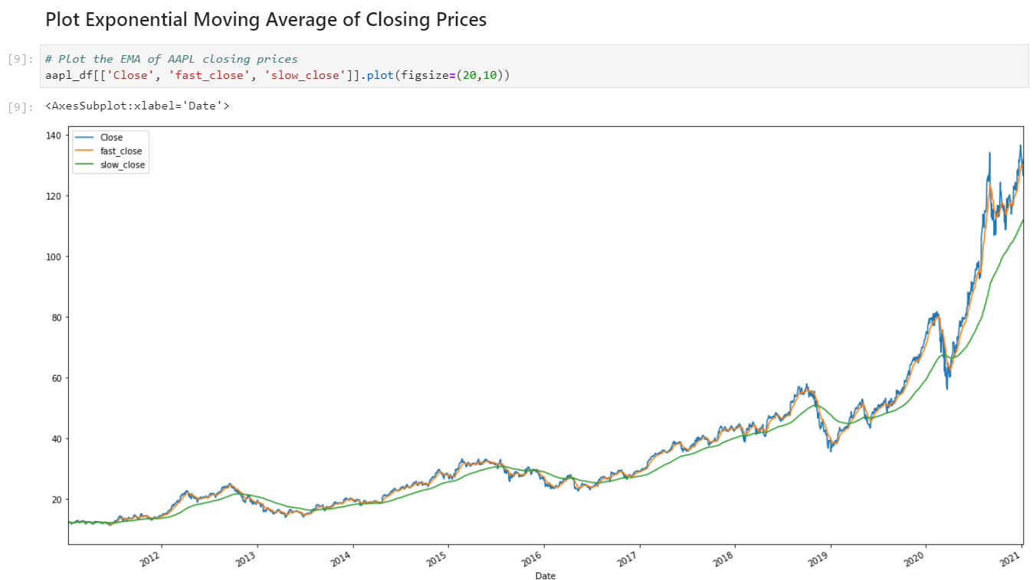
Data cleanup & Exploration (Random Forest)

Slide 8
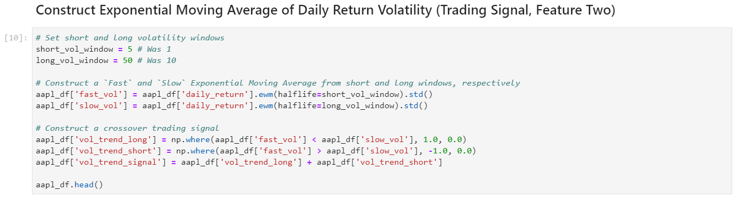
Data cleanup & Exploration (Random Forest)

Slide 9
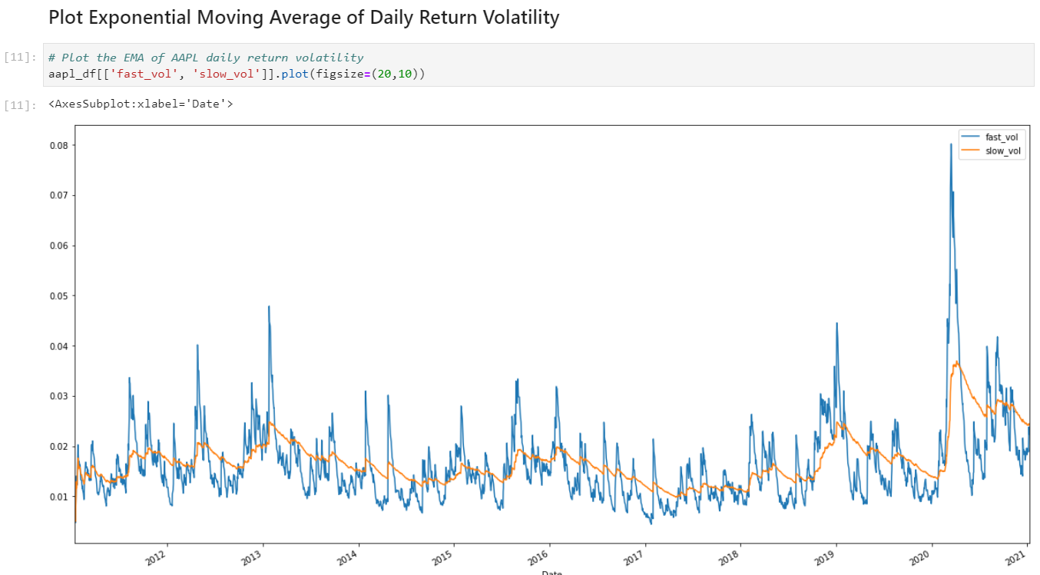
Data cleanup & Exploration (Random Forest)

Slide 10
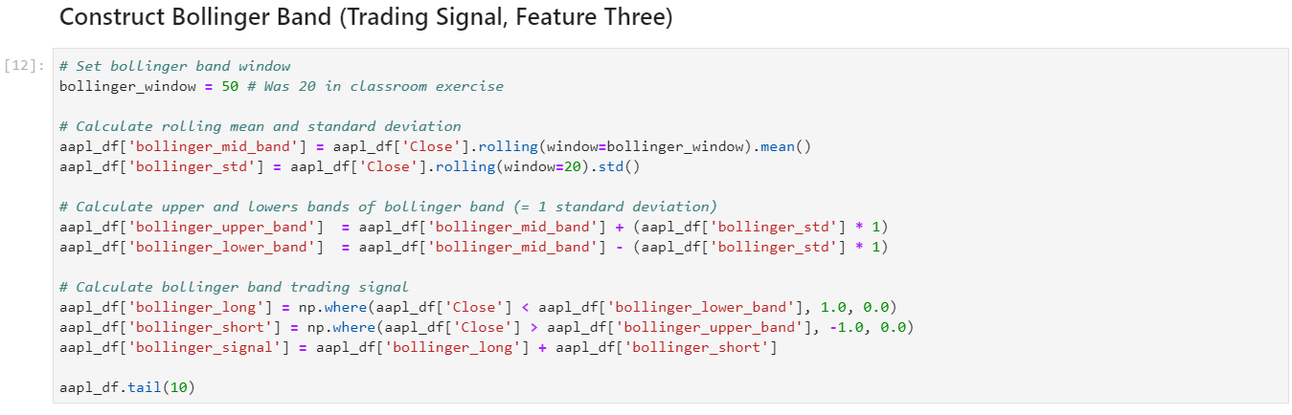
Data cleanup & Exploration (Random Forest)

Slide 11
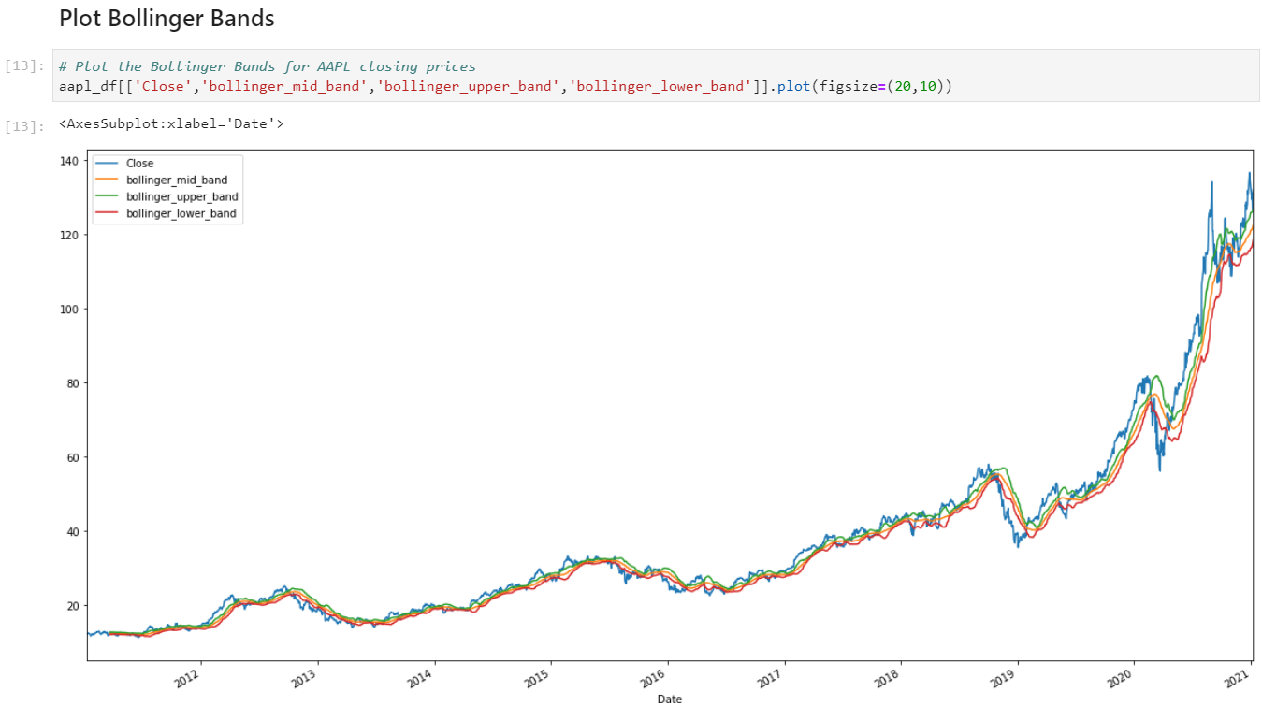
Data cleanup & Exploration (Random Forest)

Slide 12
Training Steps
Save Trading Signals as a CSV File
Read in CSV as Pandas DataFrame
Set Index, Infer DateTimeFormat, and Drop Extraneous Columns
Set X-Variable List and Filter to Obtain Associated Values
Shift the DataFrame Index by 1
Drop NAs and Replace Infs (Positive/Negative Infinity)
Construct the Dependent Variable
Assign Training and Testing Windows
Separate X and y Training Datasets
Separate X and y Testing Datasets
Train Random Forest Model
Save Pre-Trained Model Using Joblib
Save X_test and Results dataframes as CSV files
Data cleanup & Exploration (Random Forest)

Slide 13
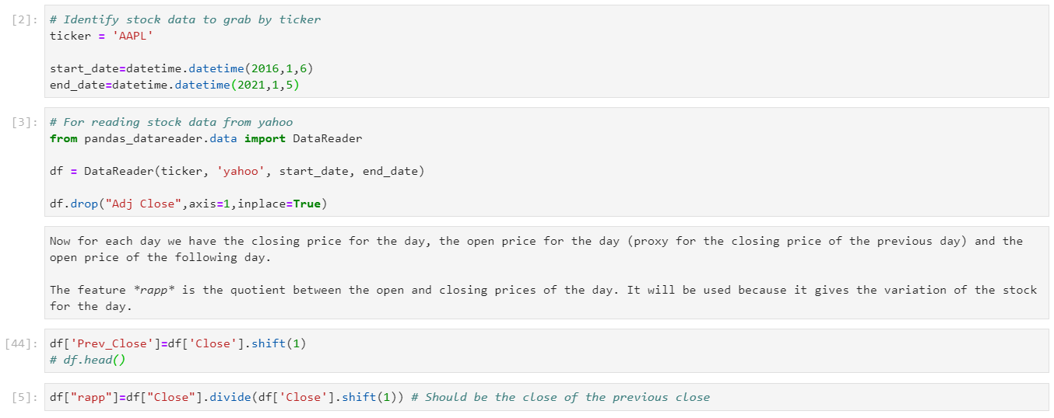
Data cleanup & Exploration (LSTM)

Slide 14
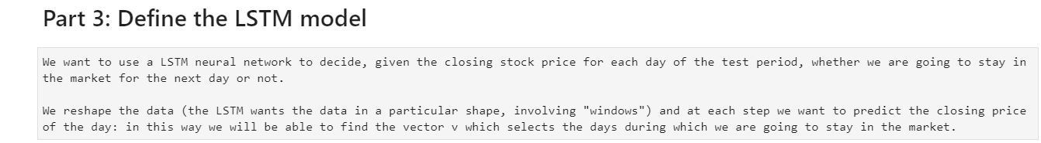
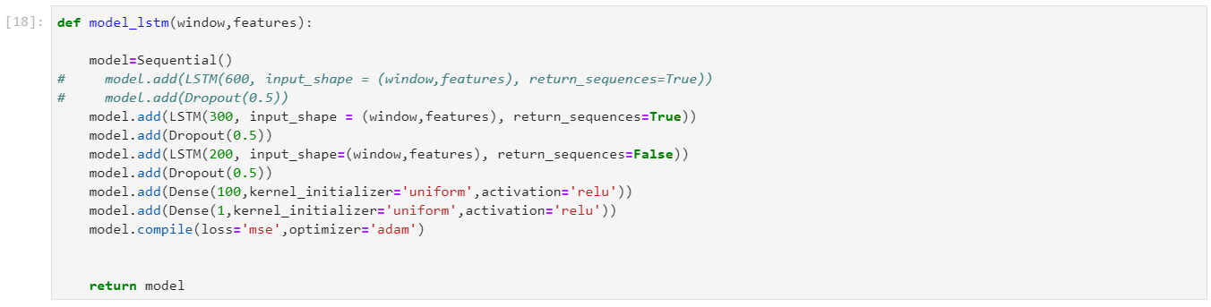
Data cleanup & Exploration (LSTM)

Slide 15
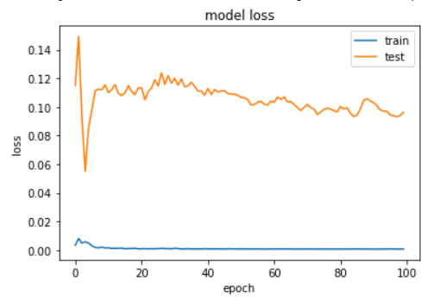
Data cleanup & Exploration (LSTM)

Slide 16
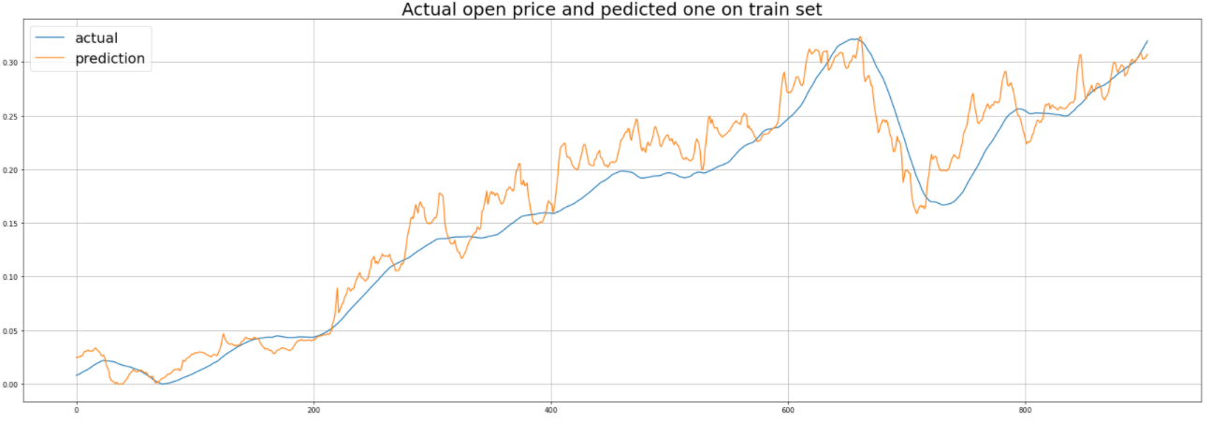
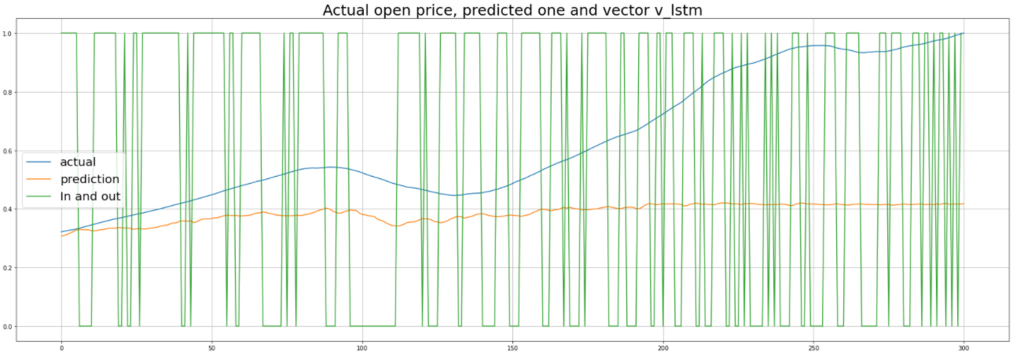
Data cleanup & Exploration (LSTM)

Slide 17
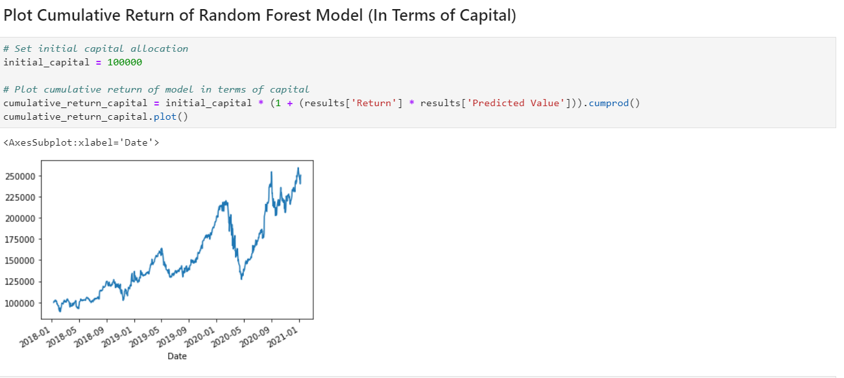
MODEL EVALUATION (Random Forest)

Slide 18
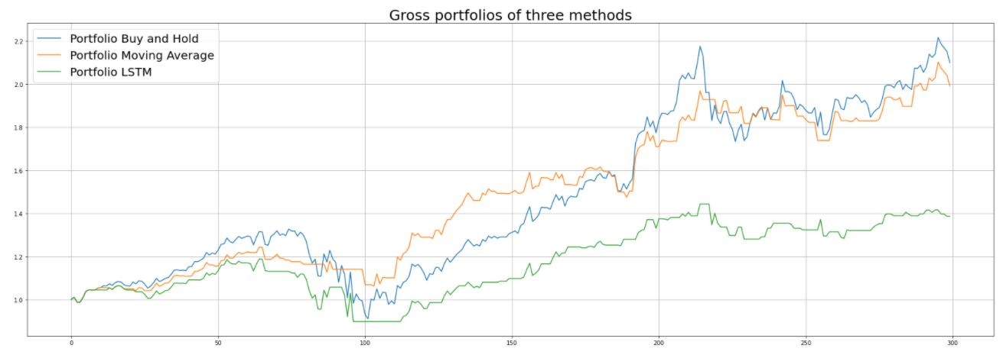
MODEL EVALUATION (LSTM)

Slide 19
MODEL EVALUATION (LSTM)

Slide 20
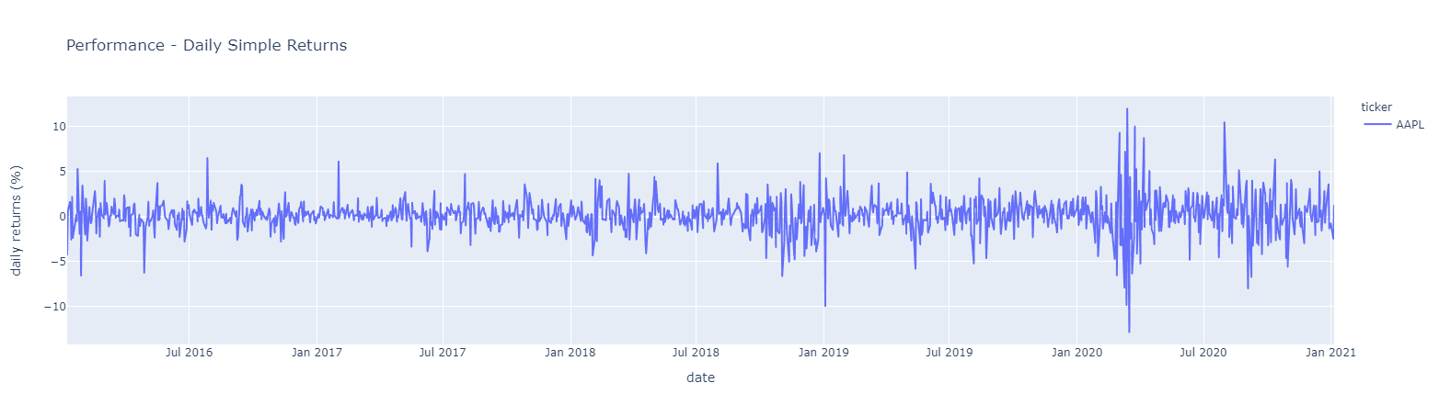
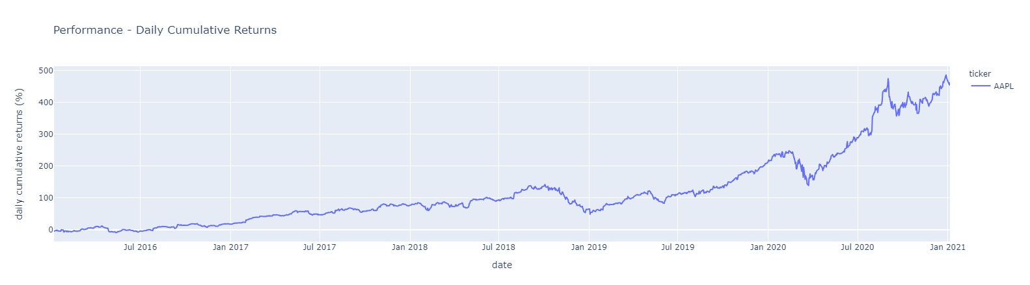
Data cleanup & Exploration (LSTM)

Slide 21
Findings
Random Forest versus LSTM Models
Predictive Abilities
Random Forest versus LSTM Models
Issues addressed
Stock price prediction versus trade timing
DISCUSSION / Q&A

